Slide 1



SAR Imager
Sponsor Presentation
March 2, 2016

Slide 2
Team Members
Engineer | Role(s) | Major | School
Luke Baldwin | Main Structure | Mechanical | FSU
Olivier Barbier | Data Processing & Image Formation | Electrical & Computer | FAMU
Jordan Bolduc | Signal Processing | Electrical | FSU
Josh Dennis | ME Project Manager & Procurement | Mechanical | FSU
Scott Nicewonger | EE Project Manager & RF | Electrical | FSU
Kaylen Nollie | Secretary, Risk Management | Mechanical | FAMU
Desmond Pressey | Antenna Hardware & Webmaster | Mechanical | FAMU
Julian Rodriquez | Component Housing | Mechanical | FSU
Kegan Stack | Calibration & Alignment | Mechanical | FSU

Slide 3
  Introduction
Kaylen Nollie

Slide 4
Outline
Project Scope
1st Generation
SAR Theory
Signal & Data Processing
SAR Structure & Horns
Calibration & Testing
Future Plans
KAYLEN NOLLIE

Slide 5
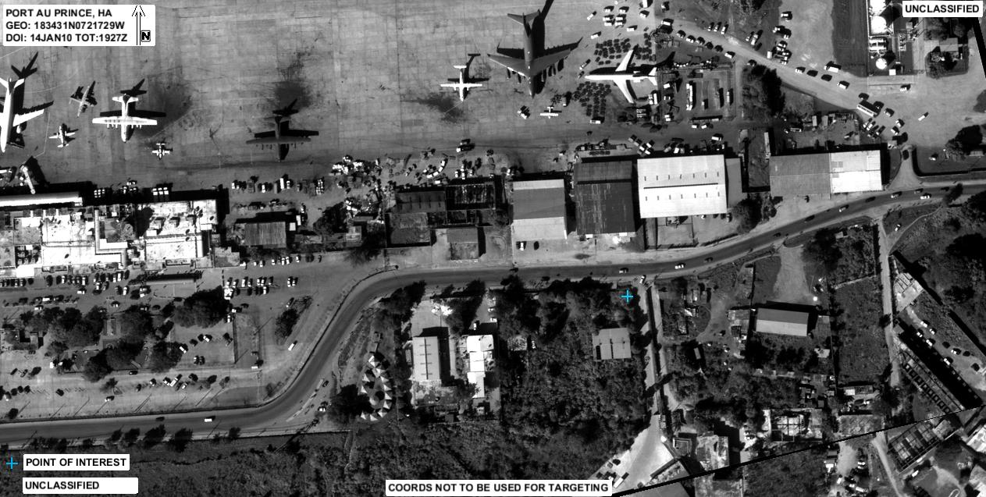
SAR Introduction
What is an SAR?
Synthetic Aperture Radar: Typically, a single antenna is attached to an aircraft flying over a target zone capturing several high resolution images to create a single image map.
  Typically for Military
KAYLEN NOLLIE

Slide 6
Project Scope
Objective:
  Develop a static, multi-antenna Synthetic Aperture Radar (SAR) Imager
    In brief: Giant metal detector
Why?:
  Security – Prevention of guns, knives, or dangerous objects from entering public facilities
    Schools
    Airports
    Office buildings
KAYLEN NOLLIE

Slide 7
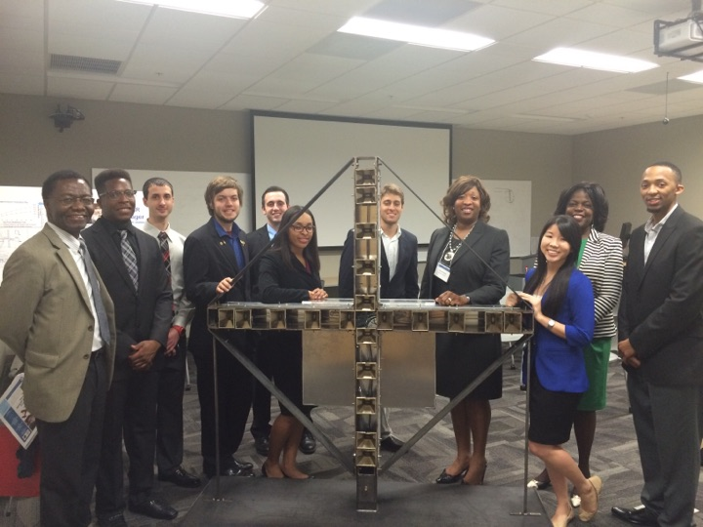
First Generation Goals
Create a Synthetic Aperture Radar:
  Project Features:
    Weapons detection for homeland security
    Multi-Antenna
    Stationary
    Low resolution
    Concealable
    Low Cost
    Relatively mobile
1st Generation Project – Class of 2015
KAYLEN NOLLIE

Slide 8
Second Generation Goals
Mechanical Engineering
Mobility
Lower Weight
Horn Adjustment
Increase Stability
Minimize Cost
Electrical Engineering
Identify reflector at 20 feet
Standalone functionality
KAYLEN NOLLIE

Slide 9
Current Status
Task | Design | Prototype | Optimization
Component Testing | ✔ | N/A | ✔
Signal Processing | ✔ | N/A | ○
Data Processing & Image Formation | ✔ | N/A | ○
Structure | ✔ | ✔ | ○
Component Housing | ✔ | ○ | ✘
Horn Holders | ✔ | ✔ | ○
Testing & Calibration Equipment | ✔ | ✔ | ○
Legend
✘ - Not Started
○ - In Progress
✔ - Completed
KAYLEN NOLLIE

Slide 10
  Project Overview &
  Theory of Operation
Scott Nicewonger, EE Project Manager

Slide 11
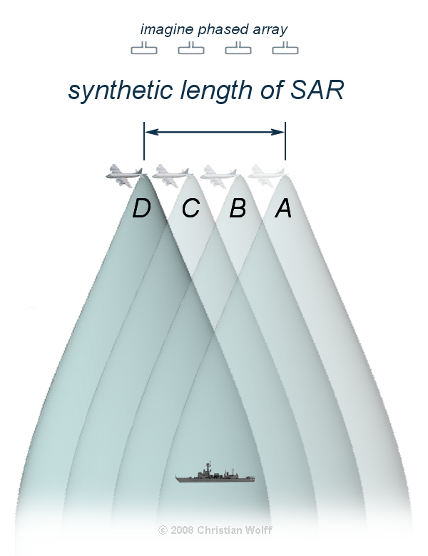
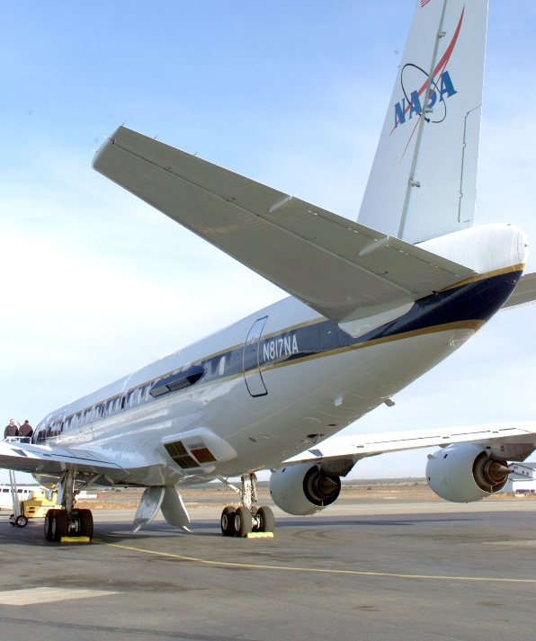
Conventional SAR
SCOTT NICEWONGER

Slide 12


Real Transmitter
Show wide beamwidths to Narrow BeamWidth
Beamwith, lambda/distance ?
TX
Synthesized Transmitter/Receiver
with Aperture Length d
TX / RX
d
Phase Center
$$≈$$
Reflective Target
RX
Real
Receiver
SCOTT NICEWONGER

Slide 13
Stationary Scanning
1-D Side View
Front View
TX
PC 1
RX₁
TX
RX
PC 2
RX
Phase Centers are formed at the midpoint between each transmitter/receiver pair
Pulsing a linear array of receivers enables a scan of the target area without any moving parts
Imager consists of linear arrays in X and Y axes to scan the entire scene
RX
PC 3
RX₂
RX
PC 4
TX
RX
RX
RX
RX
RX
RX
RX
RX
TX
RX
RX
RX₃
RX
RX
TX
RX₄
SCOTT NICEWONGER

Slide 14


Phase Slope
θ
nd sin(θ_{n})
3d sin(θ_{n})
16 Phase Centers
16 θ_{n} ‘s that map to 16 unique regions in the scene
For each θn , a 16-point complex basis function is generated
Received data is convolved (DFT) with basis functions to map energy amplitude VS frequency
2d sin(θ_{n})
d sin(θ_{n})
d
R
$$≈$$
Downrange
Scene
θ_{n}
R $≈$Rcos θ
d = 3λ
SCOTT NICEWONGER

Slide 15

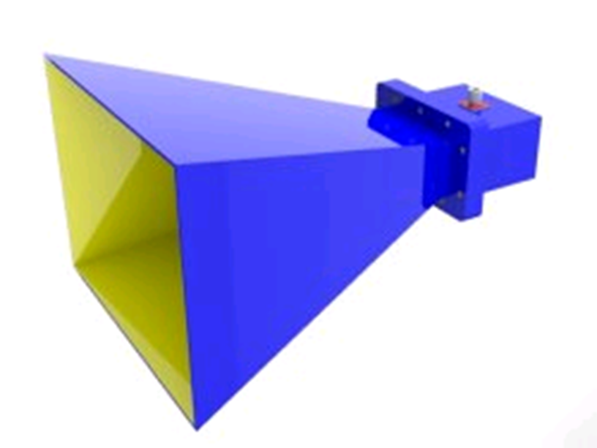
Image Formation
40 x 40 inch scene
16 - 2.5 inch
1-D Cells in
Azimuth and
Elevation
PC Display
Antenna Array
20 [ft] range to scene center
5 x 5 feet
Beams are formed
Digitally with Fourier
Transform, 16 in Azimuth
And 16 in Elevation
20nS wide RF
Pulse @ 10 GHz
16 - Azimuth
16 - Elevation
VGA Connection
SCOTT NICEWONGER

Slide 16
Generation II Design Objectives
Implement natively on the FPGA:
  Signal Processing
  System Control & Synchronization
  High-fidelity Pulsing of the Downrange Scene
  Dedicated VGA display
Implement signal processing in Matlab
Implement calibration logic
Demonstrate full-scale RF functionality with FPGA control
Re-design mechanical structure into a serviceable, user-friendly product
SCOTT NICEWONGER

Slide 17
SCOTT NICEWONGER

Slide 18
  Signal Processing
Jordan Bolduc

Slide 19
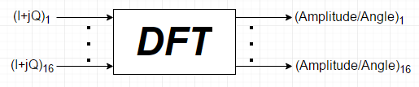
Signal Processing Approach
Reflected signal comes in as two separate components
Amplitude and angle of arrival information is necessary for energy at the scene
A Discrete Fourier Transform (DFT) is necessary
JORDAN BOLDUC

Slide 20
Goals for Signal Processing
End goal for product is for Signal Processing on the FPGA
Was working towards implementing a Fast Fourier Transform (FFT) algorithm
Decided to move to work towards an initial MATLAB solution
  Ease of coding
  Testing and debugging
  Data Manipulation
  Calibration methods
  Similar to Northrop Grumman development process
  Backbone for future development
JORDAN BOLDUC

Slide 21
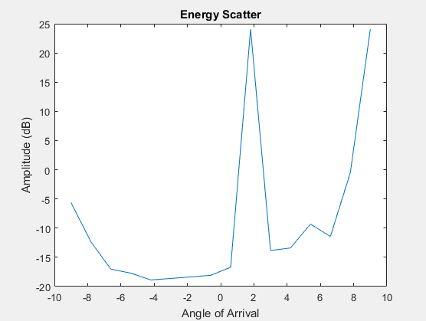
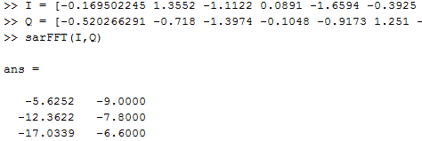
Signal Processing Code
JORDAN BOLDUC

Slide 22
Moving Forward
Will implement the laptop as part of the signal path
FPGA and MATLAB “talking” with each other
Creating custom Graphical User Interface (GUI)
Expected Challenges:
  Converting 12 bit binary word to decimal
  Accuracy after conversion
  Calibration calculations
JORDAN BOLDUC

Slide 23
  Structure Diagram & Switching
  Data Processing
  Image Formation
OLIVIER BARBIER

Slide 24
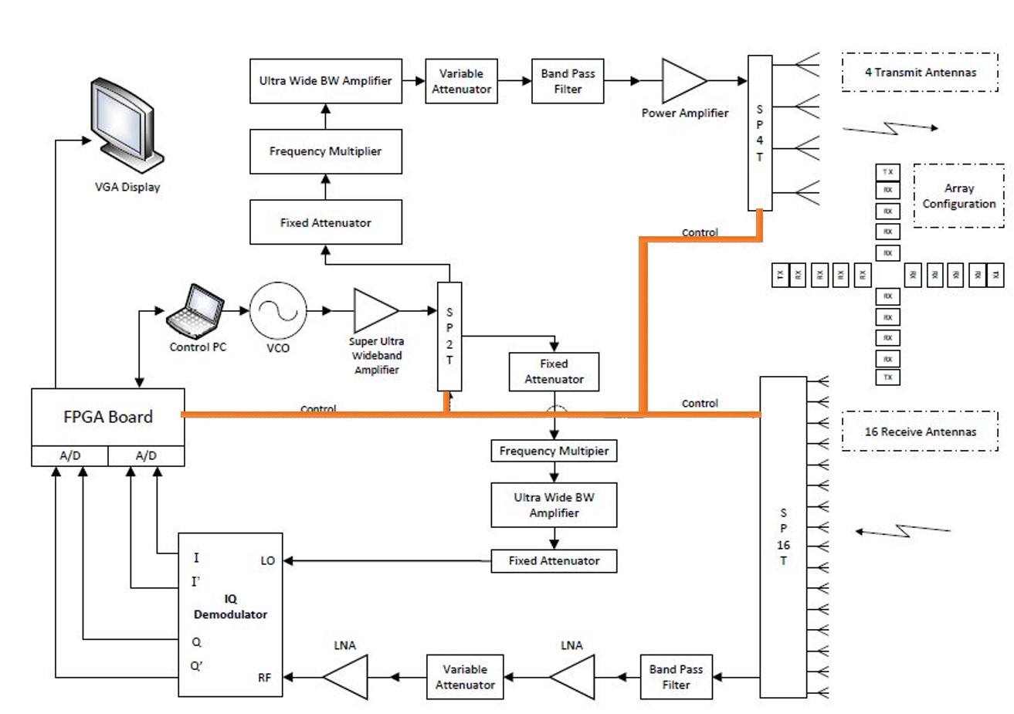
SWITCHING
OLIVIER BARBIER

Slide 25
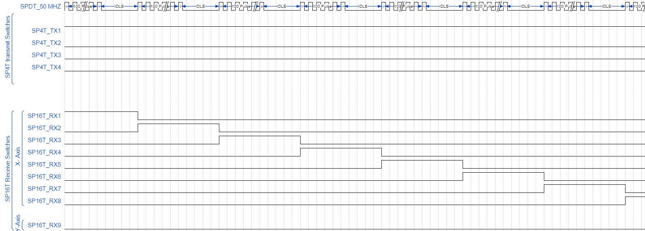
OLIVIER BARBIER

Slide 26
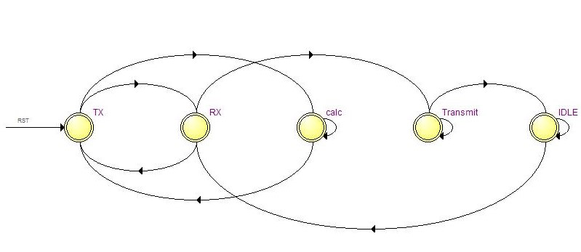
SWITCHING
State Diagram
OLIVIER BARBIER

Slide 27
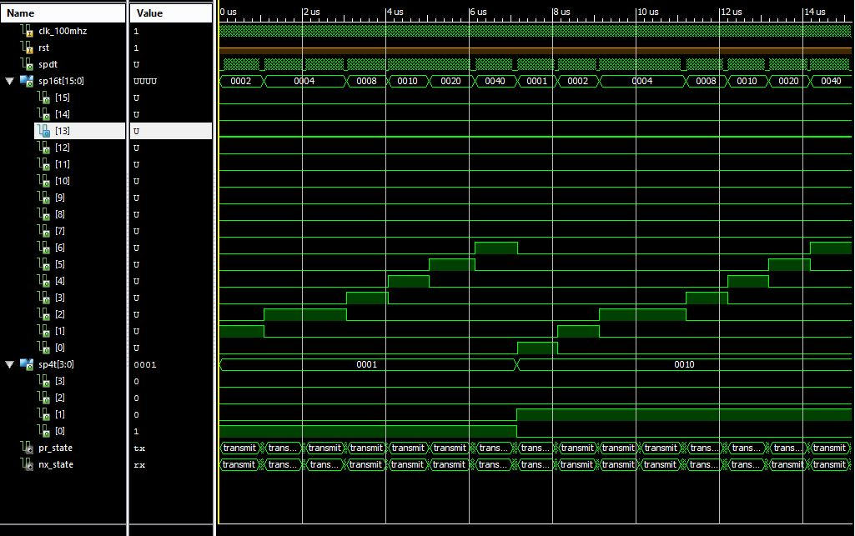
SWITCHING
OLIVIER BARBIER

Slide 28
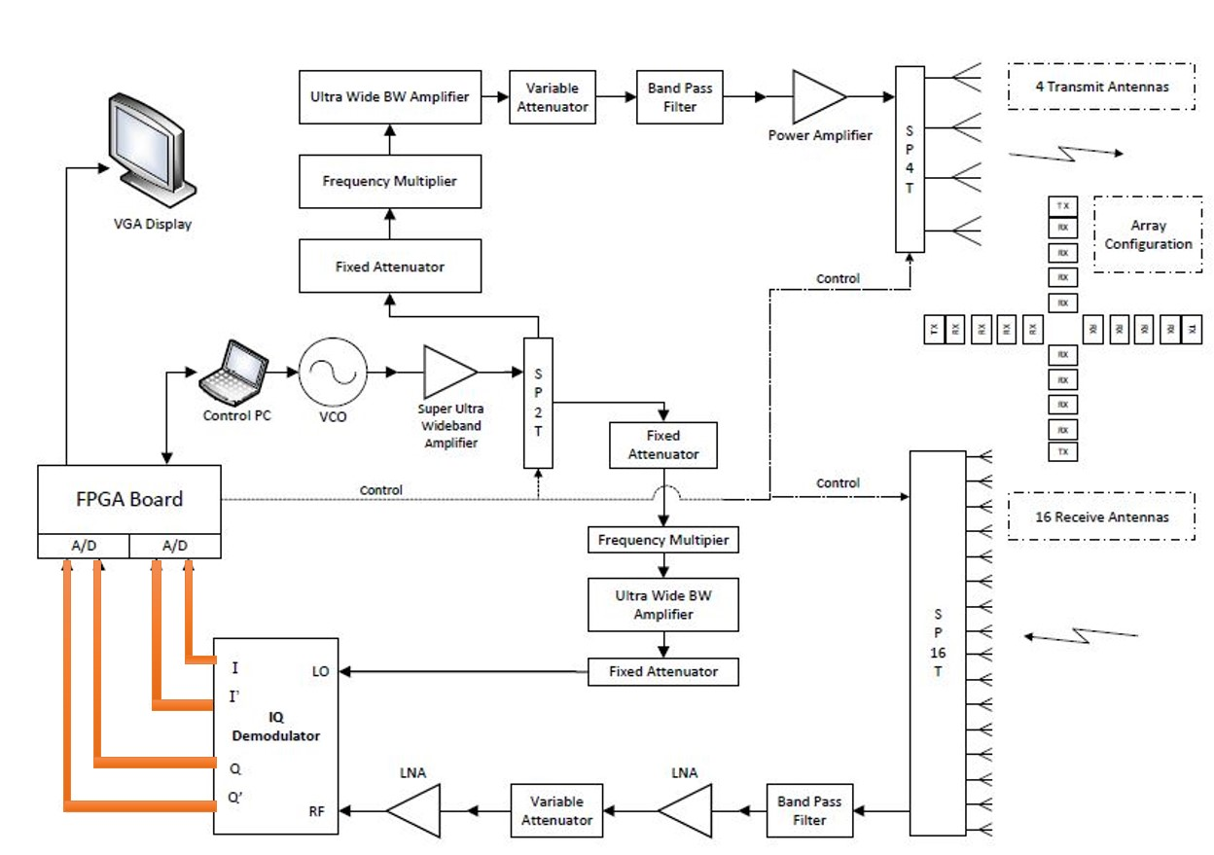
DATA PROCESSING
OLIVIER BARBIER

Slide 29
DATA PROCESSING
ADC
  Purpose
    Create a 12 bit signal of the DC voltage from the IQ demodulator.
  Victory
    DC voltage can be digitalized.
  Work to be done
    We need to implement a logic circuit to accept negative DC voltage.
Memory
  Purpose
    Read/write 2 bytes of value to/from the onboard memory of the NEXYS3.
  Victory
    Values from the switches was able to be collected and read through Matlab.
    Reading values from the memory.
OLIVIER BARBIER

Slide 30
DATA PROCESSING
Mathematical calculation
  Parallel work are being done in order to achieve the Discrete Fourier Transform
Matlab
  We were able to get magnitude and phase information using a script.
FPGA
  We are looking into Xilinx own FFT IP core generator.
OLIVIER BARBIER

Slide 31
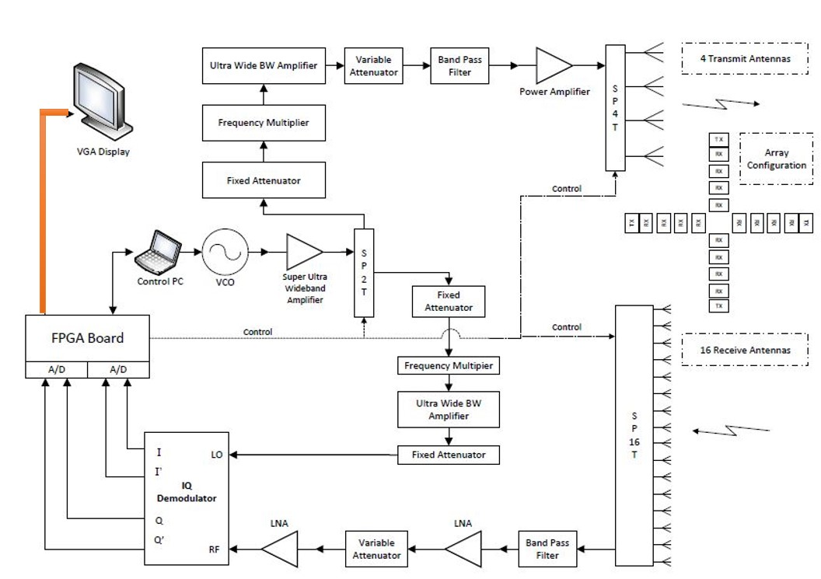
IMAGE FORMATION
OLIVIER BARBIER

Slide 32
IMAGE FORMATION
16 columns showing the magnitude of receiving signal from each antenna.
  No phase information is used in this scenario.
Image formation Possible Alternatives
  Neural Network
  Matlab image processing tool
  SAR processing algorithm (MATLAB)
OLIVIER BARBIER

Slide 33
  RF, Electrical, & Software Summary
Scott Nicewonger, EE Project Manager

Slide 34
Key Milestones (Electrical)
Completed
Signal Path Testing
VHDL Switching & Timing Logic
  Manual VHDL Switching Verified
Analog/Digital Conversion Logic
MATLAB Signal Processing Logic
Limited Display Functionality
Upcoming
Migrate to New Structure
  Migration Validation Testing
Real-time VHDL Switching
Interface MATLAB & FPGA
Dedicated Display Full-functionality
MATLAB GUI & Display
Calibration Logic
RF Range Testing
JOSH DENNIS

Slide 35
  Structure Design
LUKE BALDWIN

Slide 36
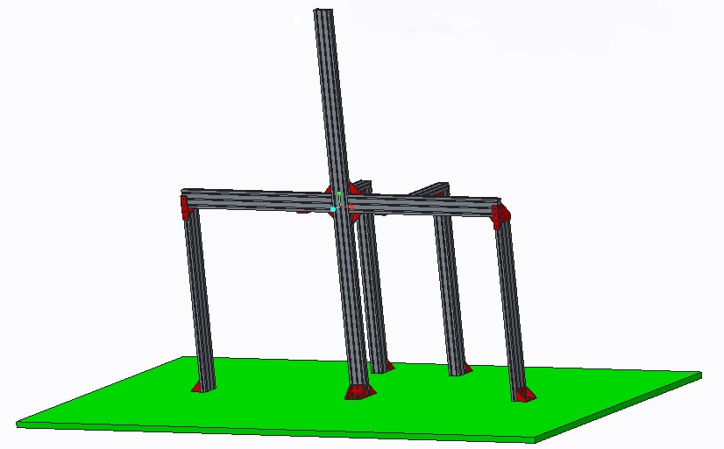
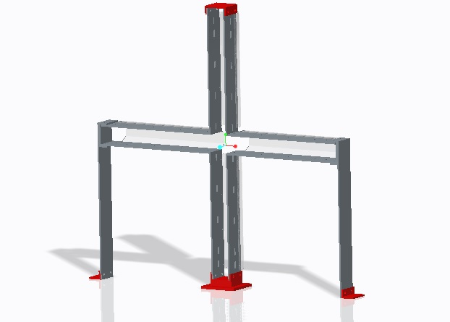
Initial Design Concepts
Concept 1: 8020 Aluminum Bars
Concept 2: Welded Aluminum Plates
LUKE BALDWIN

Slide 37
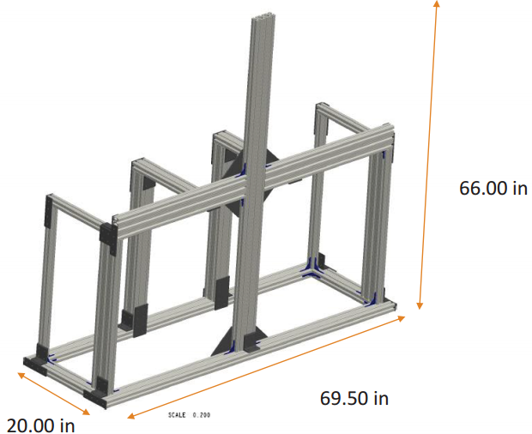
Structure Revision: Version 3
Continuation of 8020
  Change from 1” 10 series to 1.5” 15 series for increased beam strength
Rectangular Base added instead of arbitrary ground
  Caster to be added for relative mobility
  Arms added for ease transportation
Connectors added
  Keeps the structure rigid
  Useful in weight and cost analysis
LUKE BALDWIN

Slide 38
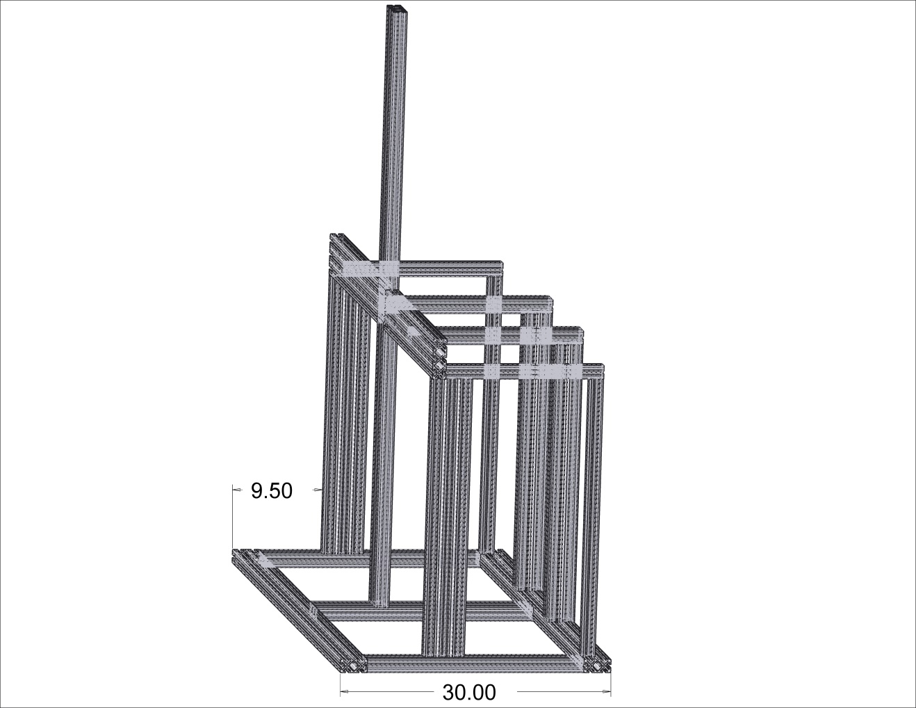
Structure Revision: Version 3.1
Moment analysis saw potential foreword rotation
Base width extended to 30”
  Increases wheel base for better mobility
  Front of structure supported
LUKE BALDWIN

Slide 39
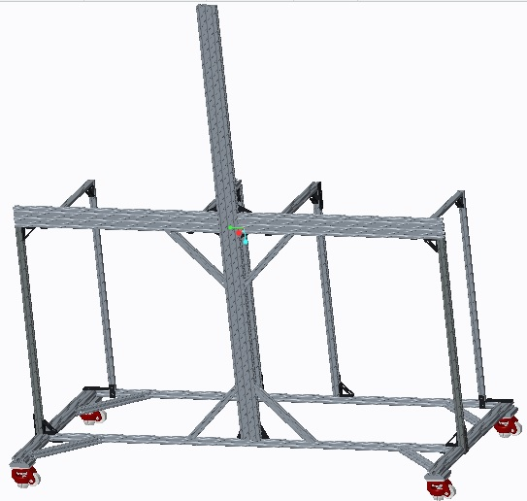
Structure Revision: Version 4
Weight analysis of V3.1 was 174 lbs without electrical components
Return to 10 series to reduce weight to 80lb goal
Beam along front removed for potential reflections
Introduction of leveling casters for alignment
Addition of triangle pieces for extra support
Weight reduced to ~55 lbs
67”
30”
66”
LUKE BALDWIN

Slide 40
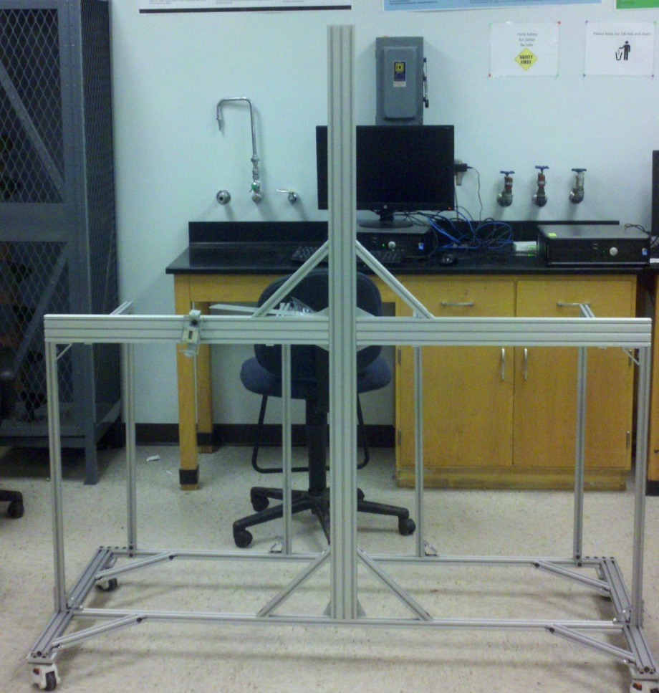
Structure Assembly
Physically assembled this version (4hrs)
Some noted challenges
  Leveling casters small 2” plastic wheel
  Slight bend in horizontal beam
  Front and back base beams oscillate independently if shook
LUKE BALDWIN

Slide 41
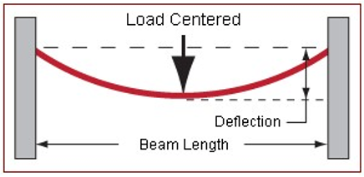
Structure Force Analysis
Performed a force analysis to check deflection and find improvements
Application of test force in center of beam with rigid endpoints
Force set to 20 lbs to account for the vertical beam and half of component box
Length set to 62”
LUKE BALDWIN

Slide 42

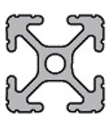
Structure Force Analysis Results
Original 1010
New 1020
Total Deflection: 0.0623 In
Total Deflection: 0.0098 In
6x less deformation
LUKE BALDWIN

Slide 43
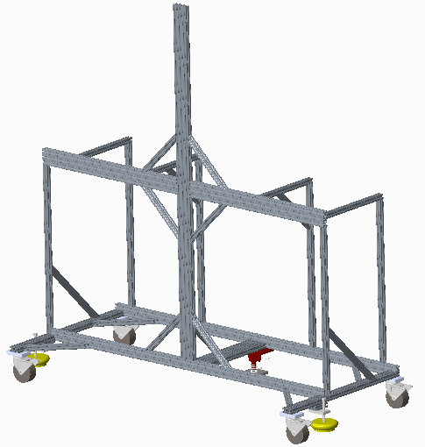
New Structure Revision: Version 5
Modification of current structure
  Weight no longer issue
  Goal is for a stable structure
Switch to rubber 4” casters
  No leveling caster presents alignment dilemma
  Solved with foot floor lock (red) and adjustable vibration feet (yellow)
More 45 degree pieces added to resist forward vibration resistance and rotation
Base pieces changed to 1020
1030 piece added to middle of base to join halves
LUKE BALDWIN

Slide 44
  Component Housing
JULIAN RODRIGUEZ

Slide 45
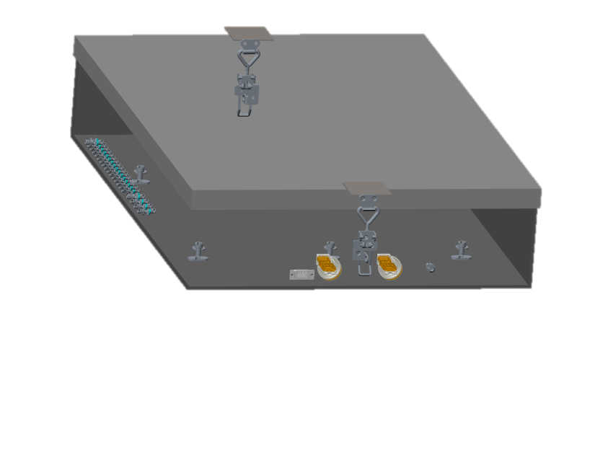
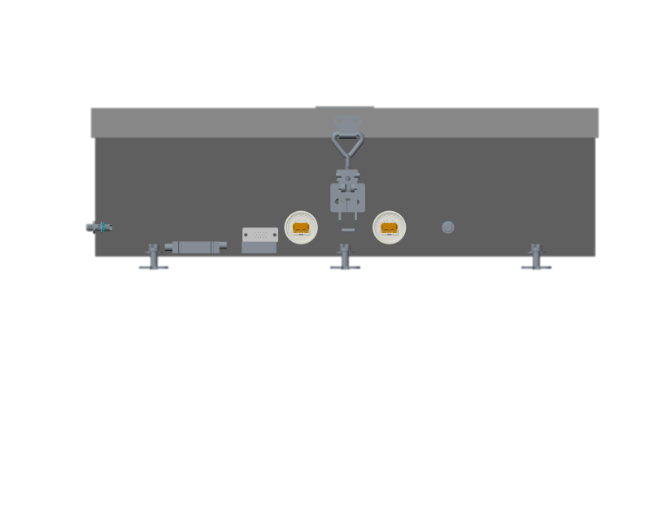
Component Housing - Final Iteration
Aluminum 6061
Exterior panel mounted connectors
  VGA
  USB x2
  Power
  SMA
24”x17”x5” at 0.09” thickness
Weight: 12.9 lbs
Lockable
JULIAN RODRIGUEZ
Notes:
The design philosophy for the box was to first and foremost be accessible for the electrical engineers to conduct their testing as well as being as sealed from the outside environment as much as possible to protect from EMI, in which I will speak about in further detail later. Every input and output to and from the box goes through a panel mounted connection to not only enclose the box but also to make connections as simple as possible. The image above is a view which hides the walls to better show each connector installed into the box. Aluminum 6061 was selected due to its high electrical conductivity, strong weldability, and of course cost. The weight is approximately (12.9 lbs) compared to last year’s weight of (roughly 40lbs) down 67.75%. The latches on the side ensure the enclosure is properly shut when needed, and have the option to install padlocks if need be.

Slide 46
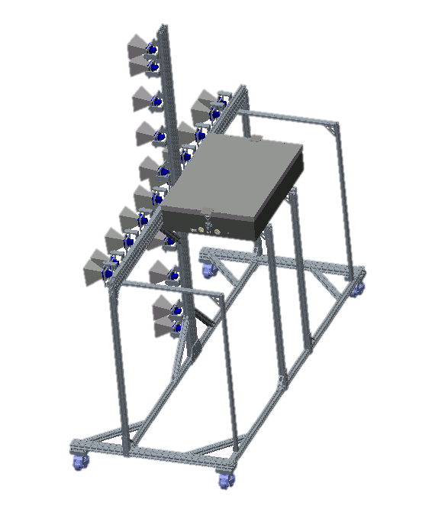
Component Housing - Final Iteration
JULIAN RODRIGUEZ

Slide 47
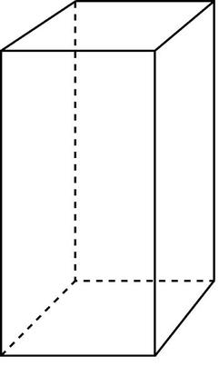



New Thermal Analysis: Component Box
JULIAN RODRIGUEZ
Notes:
With the new dimensions for the box, some recalculations had to be made to determine the new thermal analysis. After changing the surface areas and thicknesses within the MatLAB code I created for thermal analysis, again using a Thermal Resistance Network, the total heat dissipation possible actually went up. Previously, the box would have only been able to dissipate approximately (155.37 W) compared to now with a value of (178.08 W). That is up by (14.6%). With this new heat dissipation, this translates to a factor of safety of (5.12).

Slide 48

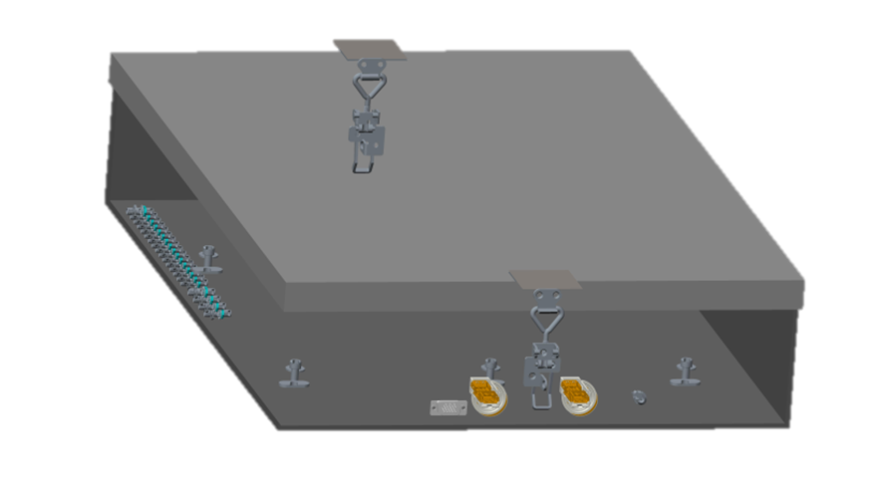
Electromagnetic Interference & Shielding
Electromagnetic interference must be minimized when designing an electrical component housing
Methods used to minimize EMI include simplifying circuitry, and shielding via gaskets
  Conductive elastomer
Make every surface sealed with a conductive material
JULIAN RODRIGUEZ
Notes:
Electromagnetic interference is emitted by every electrical device and with a high amount of electrical components running there is a lot of potential interference to try and minimize. By enclosing the components from the environment, we are preventing EMI from the outside as well as keeping the components from interfering with outside components. Keeping this in mind, the best way to approach the box design is making sure it is water-tight and any exposed area can be filled with an EMI shielding material: in our case using a conductive elastomer for the top lip that will be opened as well as any excess gaps from holes.

Slide 49
  Horn Holders
DESMOND PRESSEY

Slide 50
Horn Holder Design
Design Goals
  Independent axis adjustability
  Independent axis locking
  Lightweight
  Ease of adjustability and alignment
  No clearance issues
DESMOND PRESSEY

Slide 51
DESMOND PRESSEY

Slide 52
DESMOND PRESSEY

Slide 53
Final Design Iteration
Removed clearance issues
Moved axis of rotation
Minor dimensional changes
Corrected T-nut series
DESMOND PRESSEY

Slide 54
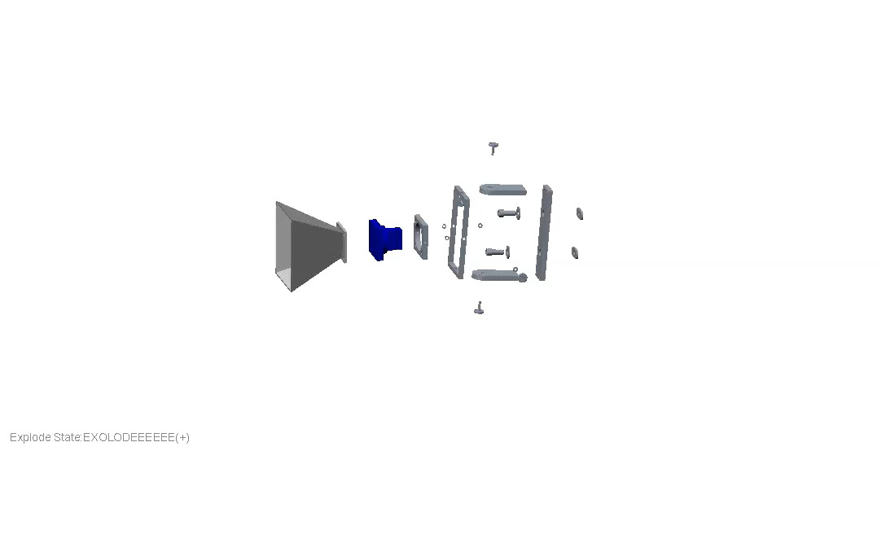

DESMOND PRESSEY

Slide 55
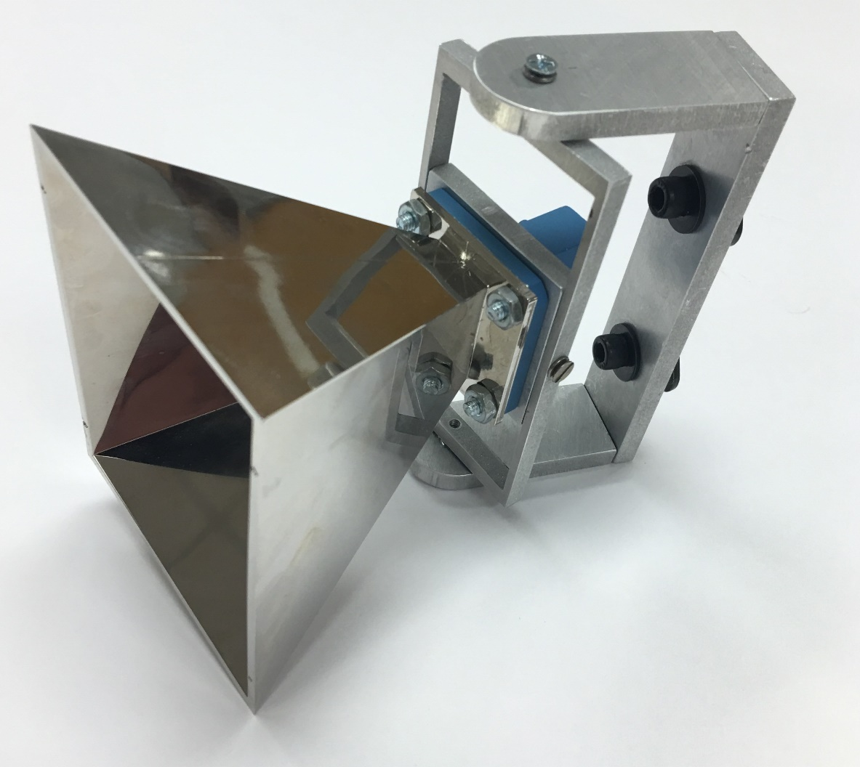
Horn Holder Prototype
2.5”
Status: Prototype confirmed
  Full scale work order submitted
  Optimize fastening method
Weight: 1.5lb
Cost: $15 per horn holder
What’s left?
  Complete fabrication / install onto frame
1”
4.64”
DESMOND PRESSEY

Slide 56
  Calibration & Testing
KEGAN STACK

Slide 57
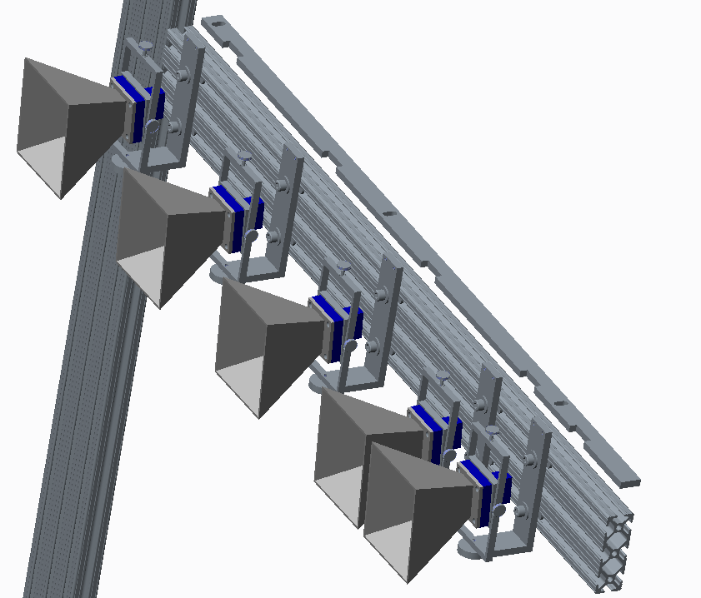
Horn Spacing - Jig
Simplest way to ensure exact horn spacing
  Compared to individual measurements
Jig made from 1/8” aluminum 6061
Cut in house with the water jet
  Accurate to within 0.003”
Measures from the intersection of the frame – out
Status: Purchase order submitted
Completion approximately 1 week
Jig
KEGAN STACK

Slide 58
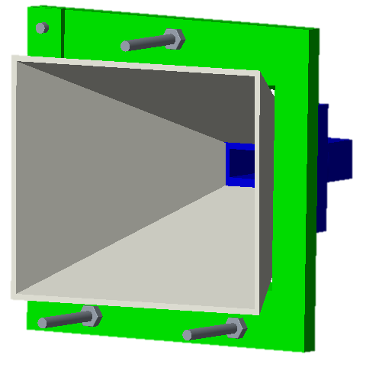
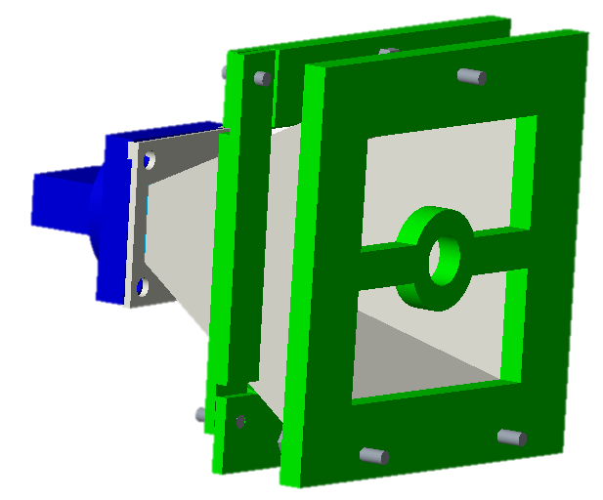
Horn Calibration – Option 1
KEGAN STACK

Slide 59
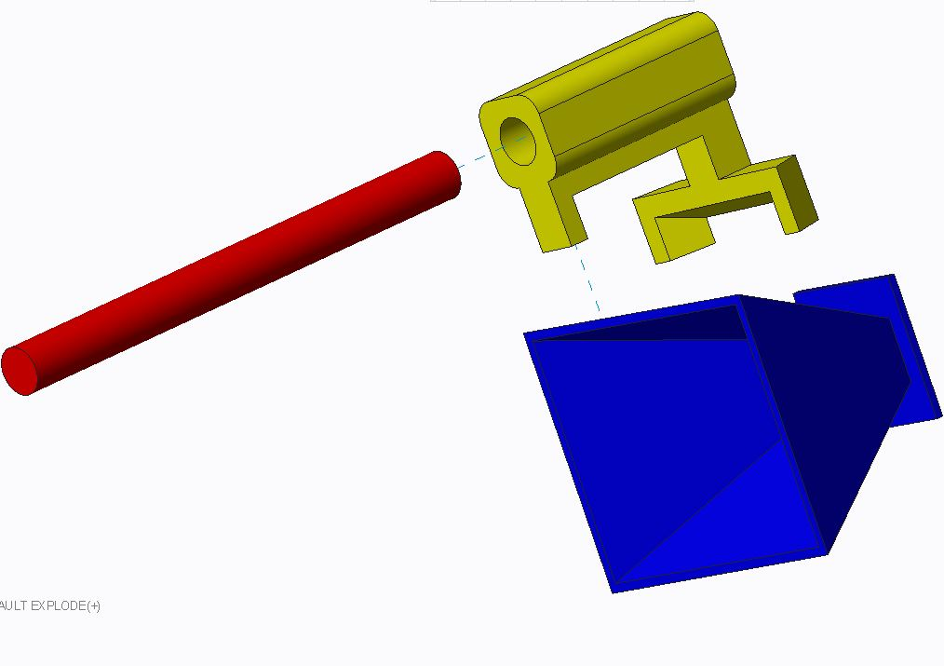
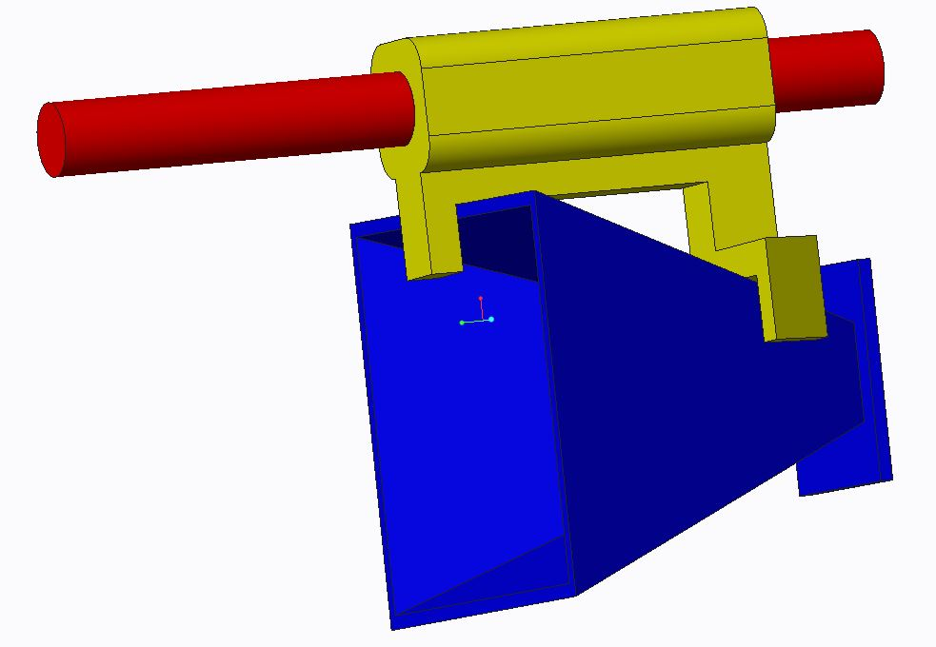
Horn Calibration – Option 2
KEGAN STACK

Slide 60
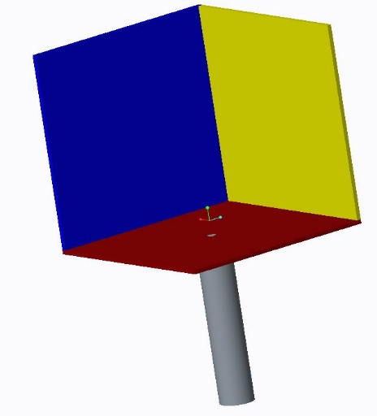
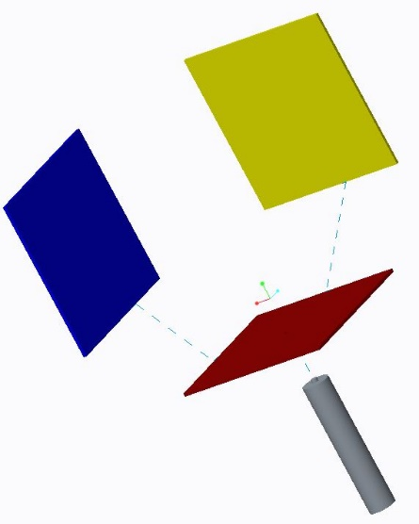
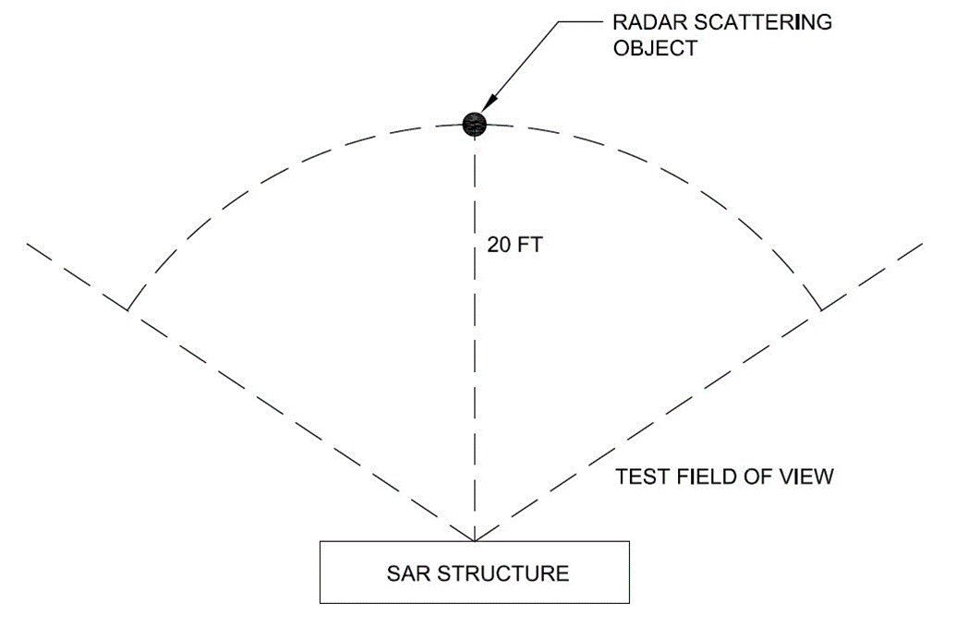
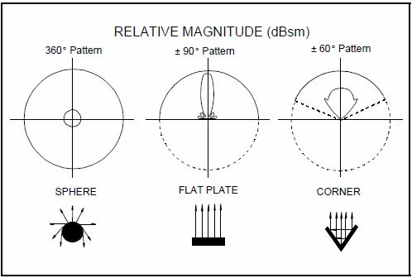
Radar Reflectors
Purpose is to create backscatter
  Reflects transmitted RF back to receiving horns
Transmit
Receive
KEGAN STACK

Slide 61
  Room Setup, Budget, & Future Plans
JOSH DENNIS, ME Project Manager

Slide 62
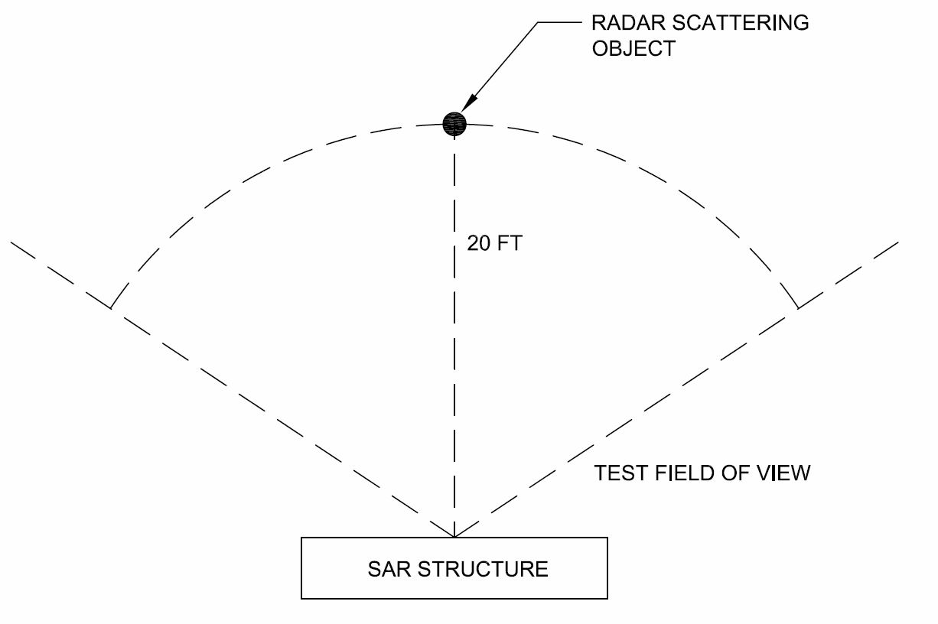
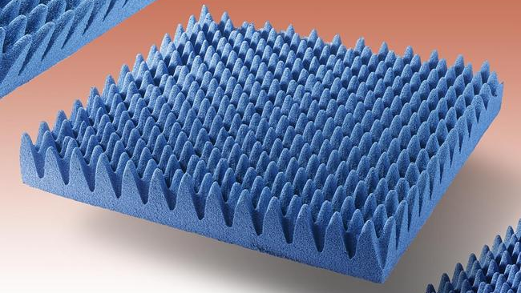
Room Setup
Considerations:
  Room requirement (30 ‘ x 30’)
  Minimal RF interference
  Easy student access
Anechoic Material
SAR Testing Layout
JOSH DENNIS

Slide 63
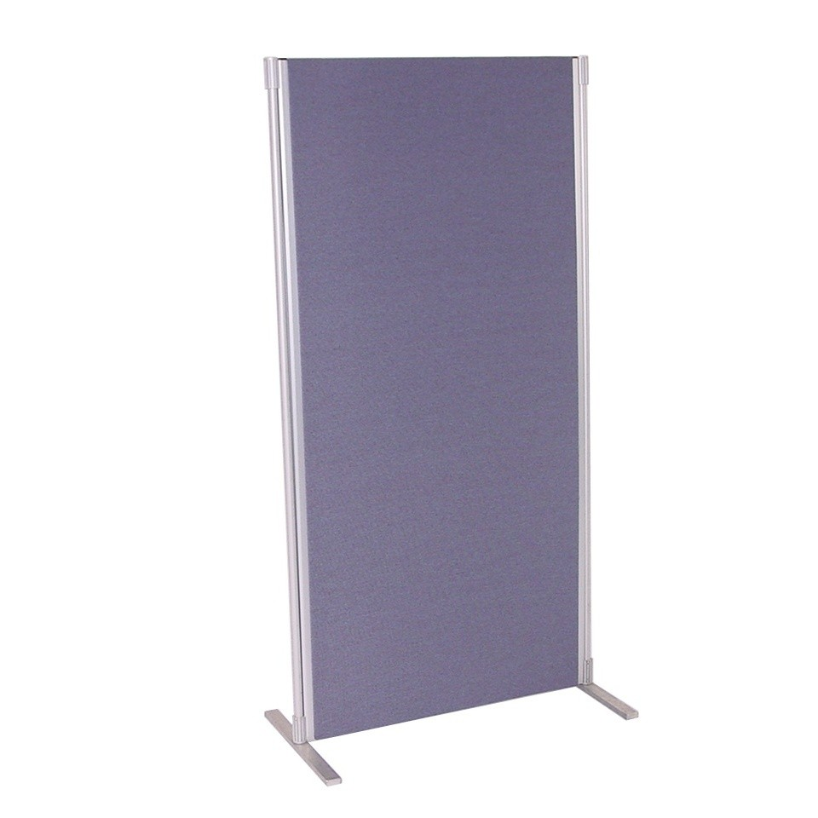
Room Setup
Problem:
  Developing anechoic room would cost $7000+
  No permanent access to a particular room
Solution:
  Create collapsible anechoic arrays
  Cover hotspots of interference
  Cost: $1500
Adhere anechoic material to modular display boards
JOSH DENNIS

Slide 64
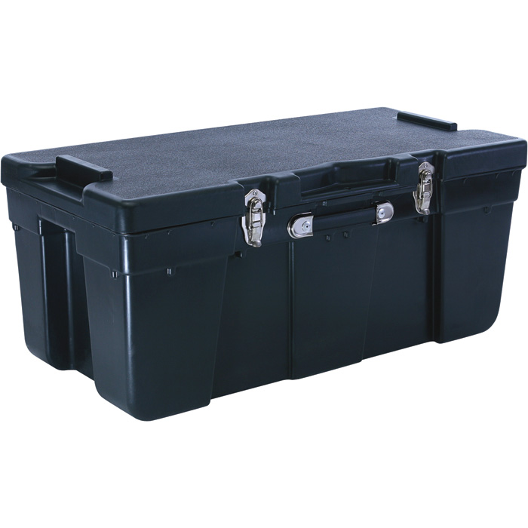
Equipment Storage
Problem:
  Project has support equipment loosely collected in unsecured boxes
    Radar Reflectors
    Tripods
    Anechoic material
    Tools
    Spare parts
Solution (Planned):
  Purchase or build a container
    Lockable
    Shock resistant
JOSH DENNIS

Slide 65
2015-2016 Budget
Items yet to be purchased:
Secure case for electrical components
Storage for testing equipment
RF Panel setup
Replacing faulty equipment
Renting testing equipment
JOSH DENNIS

Slide 66
Overall Budget (2014-2016)
JOSH DENNIS

Slide 67
Remaining Tasks 2016
Mechanical
  Machine shop fabrication
  Modifications to structure
  Anechoic panel setup
Electrical
  Migrate Electronics to Gen II Structure
  Iterative Testing
  Software Development
  RF Demonstration
JOSH DENNIS

Slide 68
Possibilities for Generation III
Mechanical
Electrical
Custom Fabrication
Wall-mounted system
Easily collapsible
Improve horn adjustment fidelity
Higher resolution
  Enhance array design
“Heat map” display
Weapon Signature Discrimination
  Improve image resolution & display
  Neural network
Automated alert system
  Wireless link to security center
JOSH DENNIS

Slide 69
Acknowledgements
College of engineering
Mechanical
Electrical
Instructors:
  Dr. Nikhil Gupta
  Dr. Chiang Shih
Faculty Advisor:
  Dr. Dorr Campbell
Instructor:
  Dr. Jerris Hooker
Faculty Advisors:
  Dr. Simon Foo
  Dr. Shonda Bernadin
  Dr. Rajendra Arora
JOSH DENNIS

Slide 70
Sponsor
Northrop Grumman
Mike Blue
Pete Stenger
Mechanical Engineer
Mechanical Technology
Engineer, RF Microwave Design
RF Devices and Packaging
JOSH DENNIS

Slide 71
Questions?

Slide 72
References
http://stores.cumingmicrowave-online-store.com/c-ram-fac-3-x-24-x-24/
http://www.eventfurniturehire.co.nz/catalog/product/gallery/id/99/image/109/
http://www.northerntool.com/shop/tools/product_200377214_200377214

Slide 73
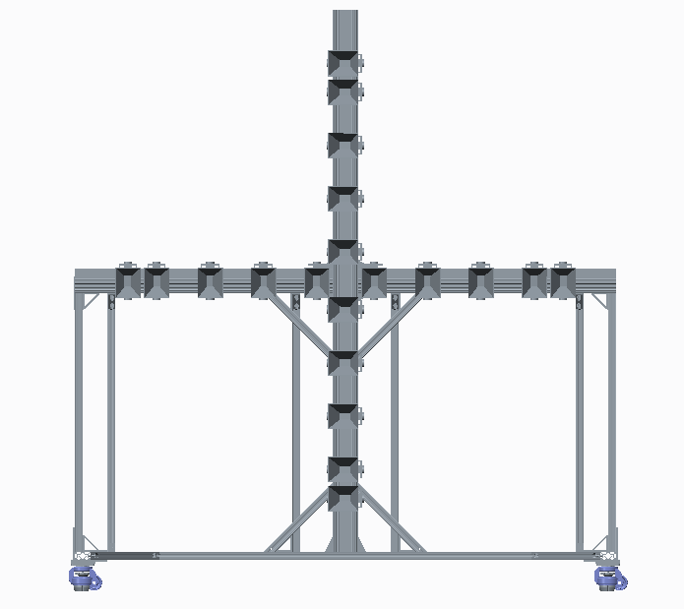
FRAME
66”
30”
7.09”
3.54”
70”
Kegan Stack

Slide 74
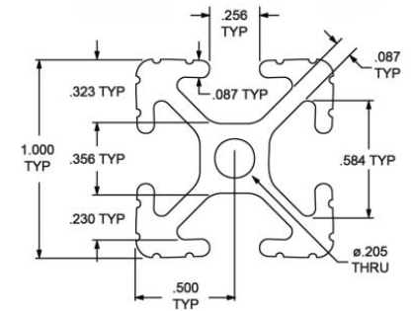
Structure Examination: V1
8020 Aluminum Beams
  Provide excellent weight to strength ratio
  Easy to assemble
  Light Machining Required
  Joined together by ¼-20 screws and plates
  Recommended to us from Mike Blue
Horns mounted to the front pointing normal to the beam
61”
64”

Slide 75
Structure Examination: V2
Solid Aluminum Beams
  Similar Design as last year’s rendition
  Number of beams reduced
  Welded together for better strength
  Heavy Machining Required
Horns sandwich mounted between two 5” beams
Design ultimately rejected due to machining difficulty
64.55”
63.65”

Slide 76
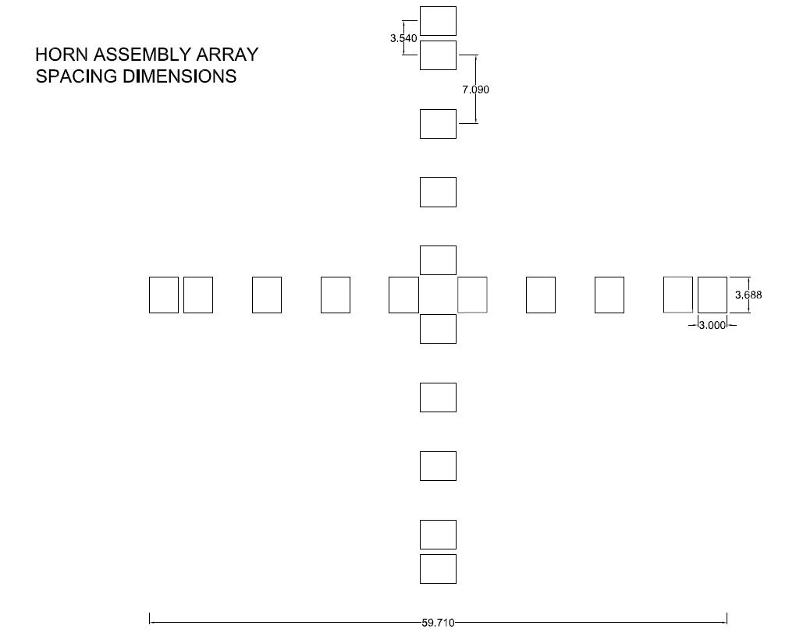
(INCHES)

Slide 77
Safety
Uses low-powered X-band Radio Frequency (RF) to image objects from a distance (20 feet)
RF Exposure Safety Guidelines
  ANSI/IEEE C95.1-1992
  FCC 47 C.F.R. 1.1307(b), 1.1310, 2.1091, 2.1093
Limit for human exposure: 1 mW/cm²
SAR Peak Transmit: 0.0076 mW/cm²
Scott Nicewonger

Slide 78
